Slide 1

AI 전문가 교육과정 : Learning Algorithms I (Continual Learning - Lab)
Sangwon Jung, Hongjoon Ahn
toto6599@naver.com, hongjoon0805@naver.com
Department of Electrical and Computer Engineering

Slide 2
Outline
Review of EWC and ER
Goal of Lab
A Brief Explanation for Source Codes

Slide 3
Outline
Review of EWC and ER
Goal of Lab
A Brief Explanation for Source Codes

Slide 4
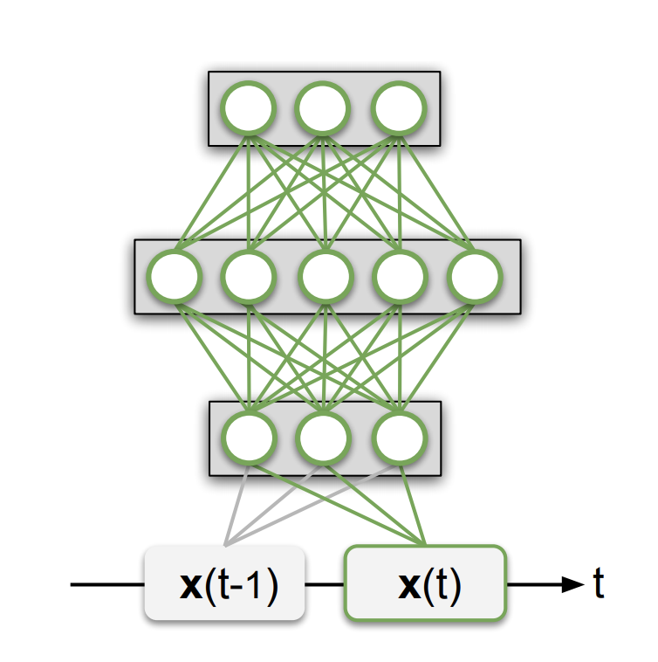
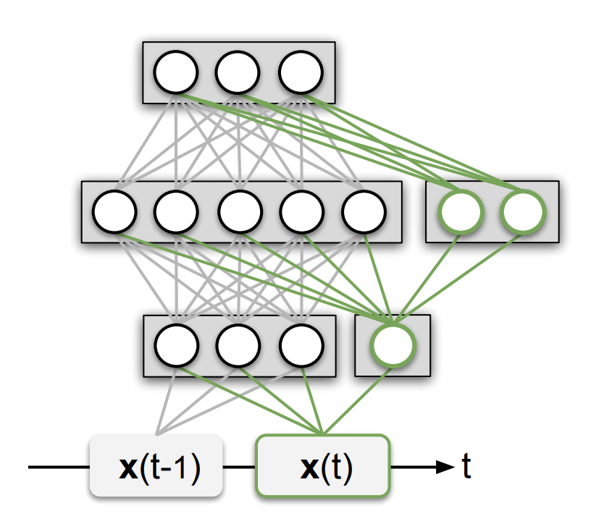
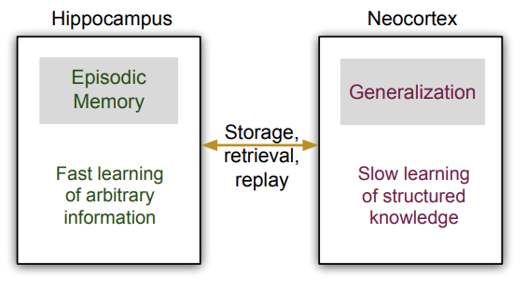
Topic for Practice
[Parisi et al., Continual Lifelong Learning with Neural Networks: A Review, arXiv:1802.07569 2019]
We tackle two methods of Regularization/Memory based CL approach
Regularization – EWC
Memory replay – ER
Regularization
Parameter Isolation /
Dynamic Architecture
Memory replay

Slide 5
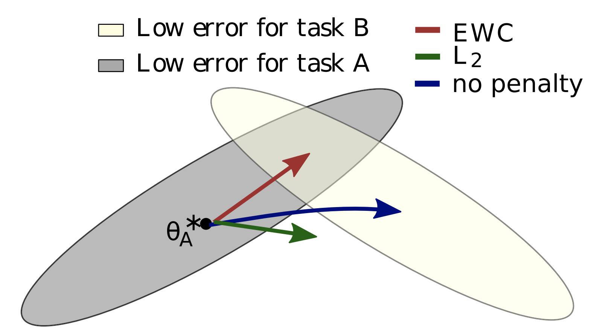
Regularization-based methods
Key idea
Identify which nodes/weights are important for each task
Put high regularization to the important nodes/weights
Mainly focus on the stability
[Kirkpatrick et al., Overcoming catastrophic forgetting in neural networks, PNAS 2017]

Slide 6
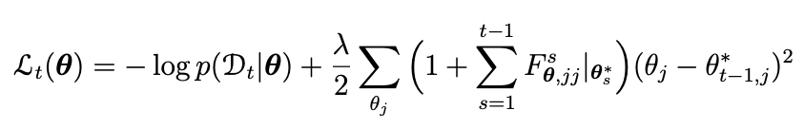
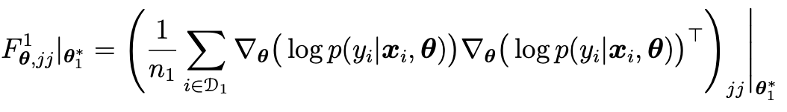
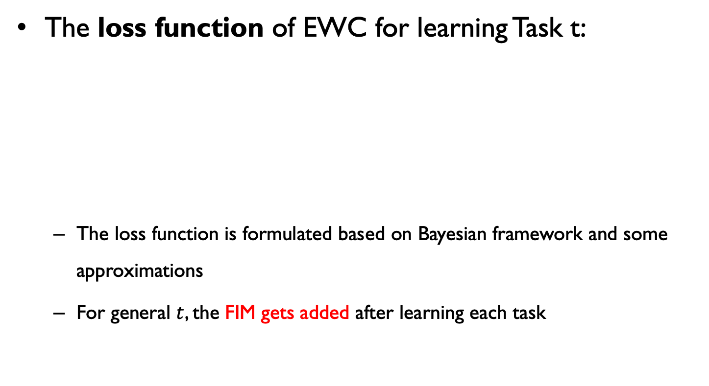
Elastic Weight Consolidation (EWC)
The loss function of EWC for learning Task t:
The loss function is formulated based on Bayesian framework and some approximations
For general $t$, the FIM gets added after learning each task

Slide 7
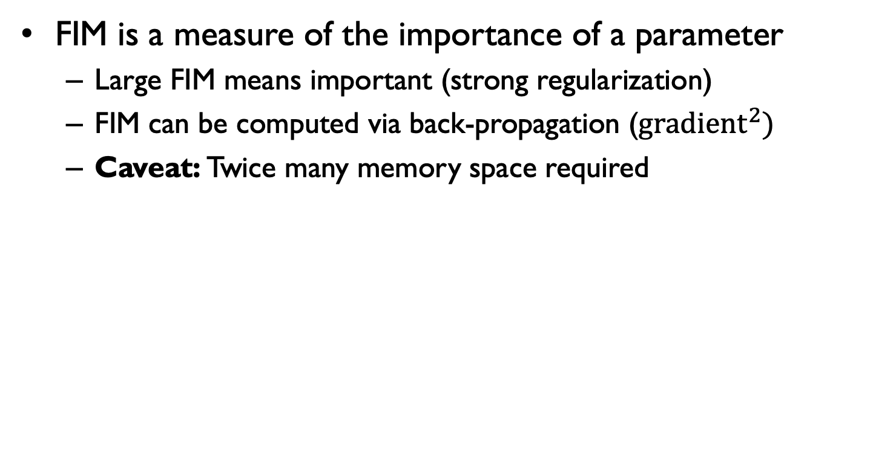
Elastic Weight Consolidation (EWC)
FIM is a measure of the importance of a parameter
Large FIM means important (strong regularization)
FIM can be computed via back-propagation (${gradient}^{2})$
Caveat: Twice many memory space required

Slide 8
Elastic Weight Consolidation (EWC)
EWC mitigates catastrophic forgetting in SL
Permuted MNIST task

Slide 9
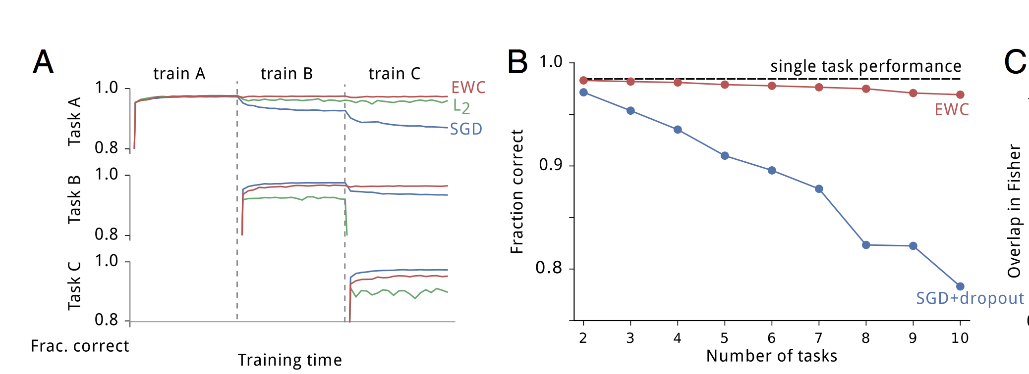
Elastic Weight Consolidation (EWC)
EWC mitigates catastrophic forgetting in a SL
Permuted MNIST task
Simple fine-tuning, L2 regularization do not work

Slide 10
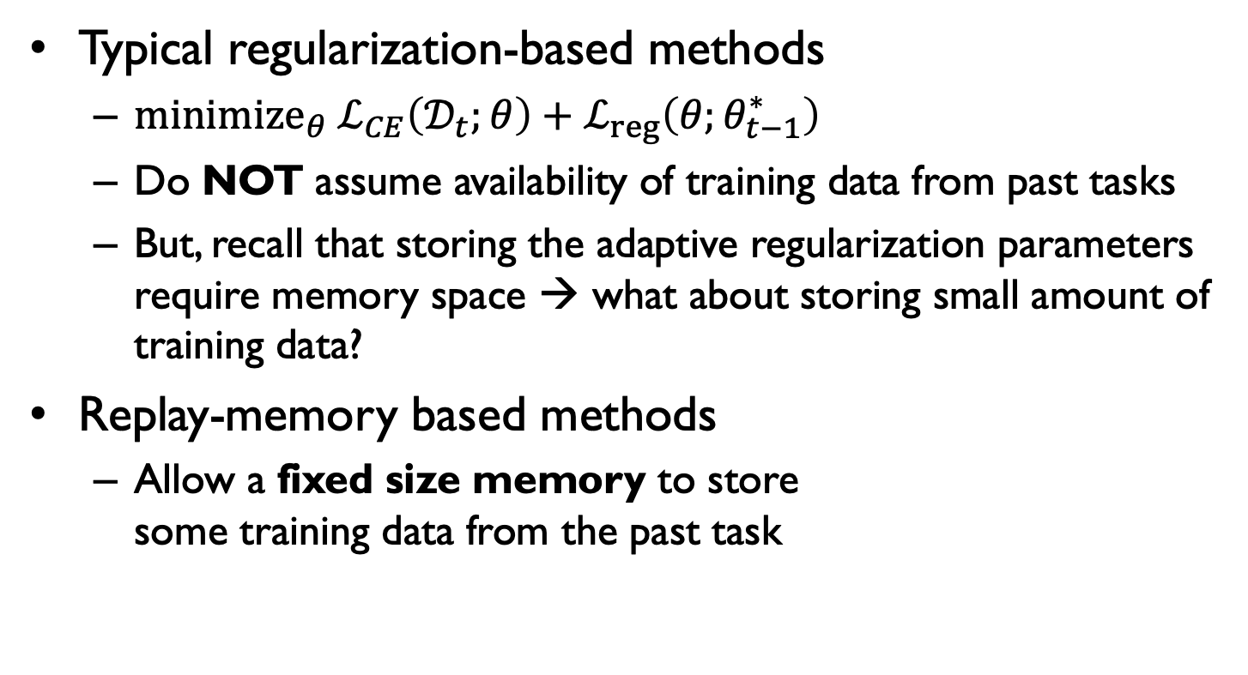

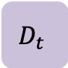
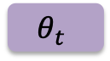
Replay-memory based methods
Typical regularization-based methods
${minimize}_{θ} ℒ_{CE}\left(𝒟_{t};θ\right)+ℒ_{reg}\left(θ;θ_{t−1}^{∗}\right)$
Do NOT assume availability of training data from past tasks
But, recall that storing the adaptive regularization parameters require memory space → what about storing small amount of training data?
Replay-memory based methods
Allow a fixed size memory to store some training data from the past task
$$θ_{t}$$
Fixed size Memory
$$ℳ$$
$$D_{t}$$

Slide 11
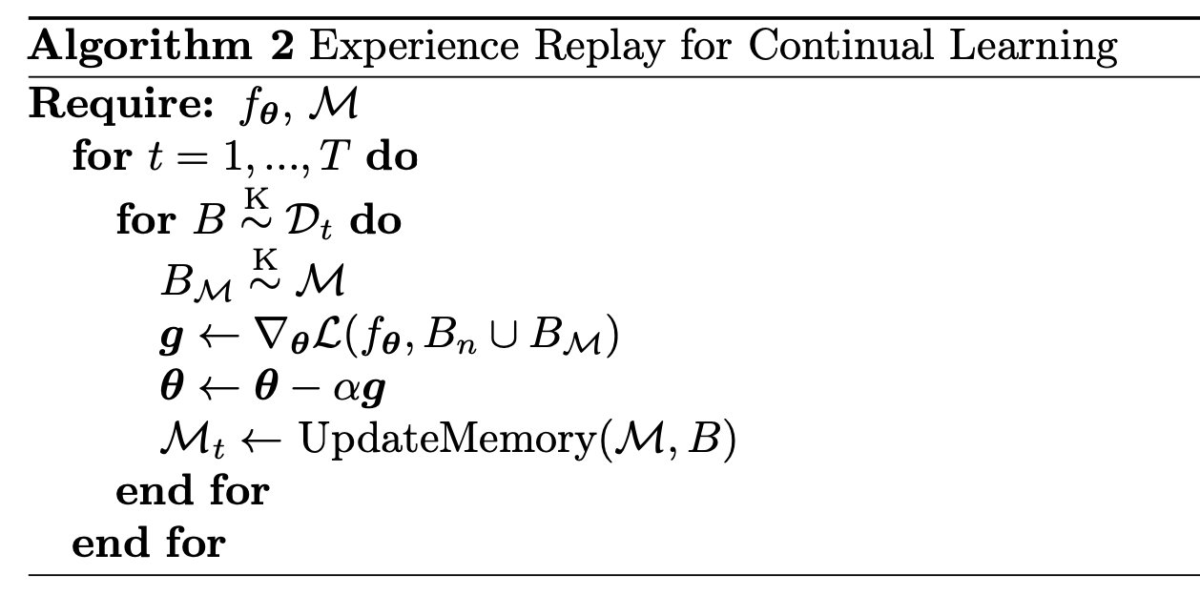
Experience Replay for Continual Learning
Experience replay (ER)
Directly train on the examples stored in a memory
Doubles the size of the minibatch by stacking the actual minibatch from the current task with a minibatch of examples from the memory
[Chaudhry et. al, On Tiny Episodic Memories in Continual Learning. ICLR, 2019]

Slide 12
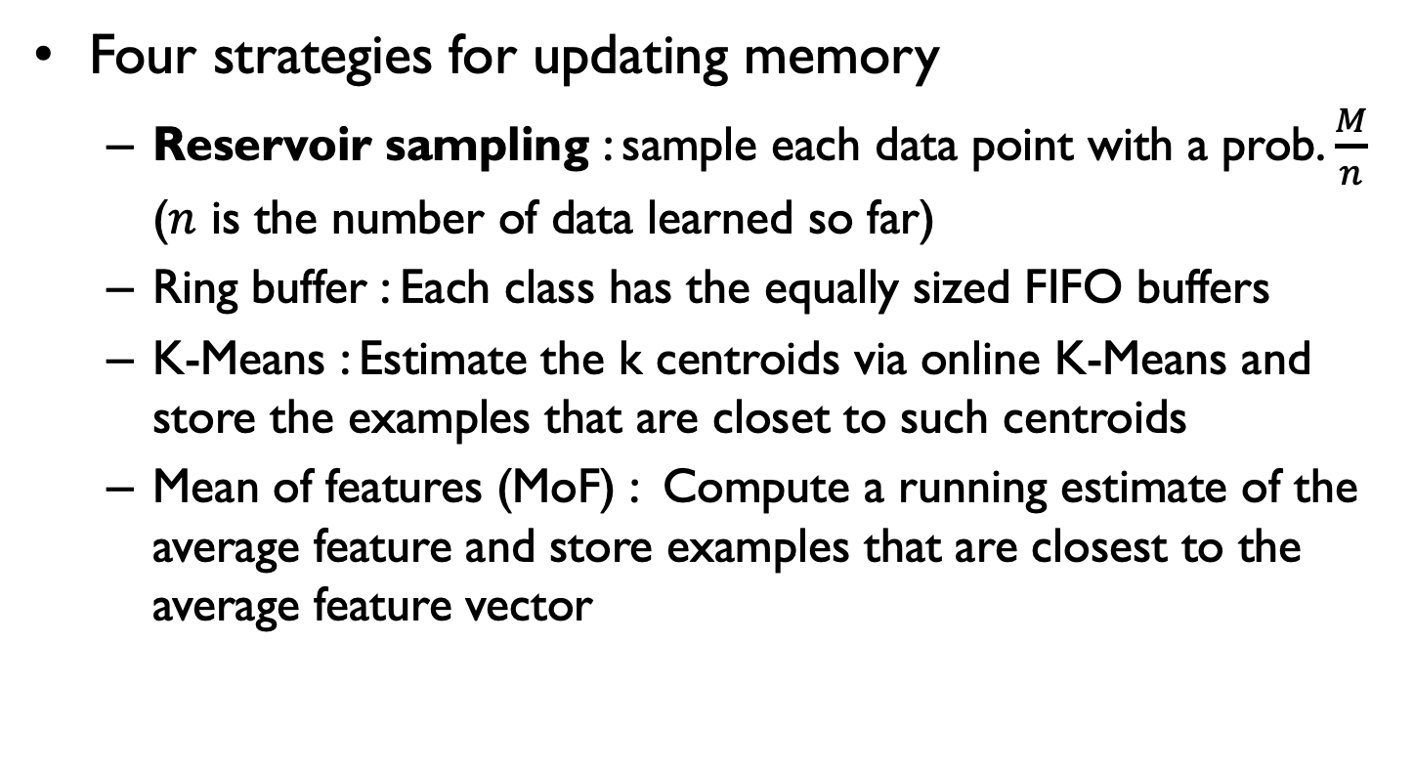
Experience Replay for Continual Learning
Four strategies for updating memory
Reservoir sampling : sample each data point with a prob. $\frac{M}{n}$ ($n$ is the number of data learned so far)
Ring buffer : Each class has the equally sized FIFO buffers
K-Means : Estimate the k centroids via online K-Means and store the examples that are closet to such centroids
Mean of features (MoF) : Compute a running estimate of the average feature and store examples that are closest to the average feature vector

Slide 13
Outline
Review of EWC and ER
Goal of Lab
A Brief Explanation for Source Codes

Slide 14
Goal of Lab for EWC
Experimental Setting
Network architecture : 2 layers MLP network with multi-head
Continual learning scenario : Split MNIST with 5 tasks
Complete unimplemented functions of EWC
Implement three functions in day1_ewc.ipynb
Criterion(self, output, targets)
Compute_diag_fisher(self, device=None)
Update_fisher(self, device)
Plot a figure for the results

Slide 15
Goal of Lab for EWC
Implement three functions
Criterion(self, output, targets) : implement the loss function of EWC
Compute_diag_fisher(self, device=None) : implement the calculation of the diagonal of fisher matrix for a current task
Update_fisher(self, device) : update fisher matrix through moving average
Update_fisher()
Criterion()
Compute_diag_fisher()

Slide 16
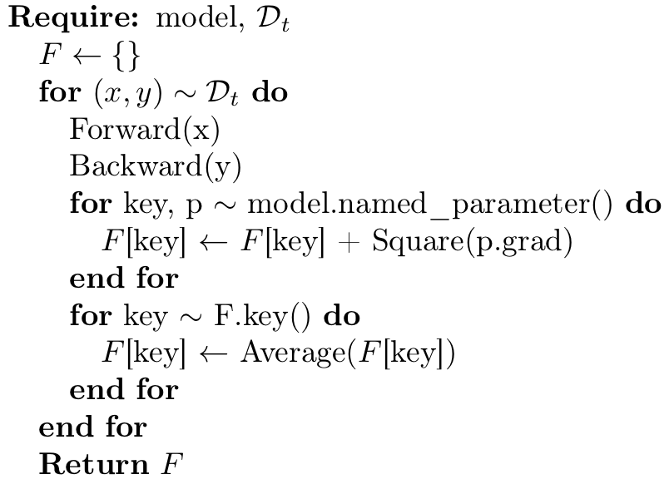
Goal of Lab for EWC
Compute_diag_fisher(self, device=None)
Pseudo code
Practically, we set the batch size to 20 instead of 1
여기로 옮겨야함
Key indicates the name of
each module of the model

Slide 17
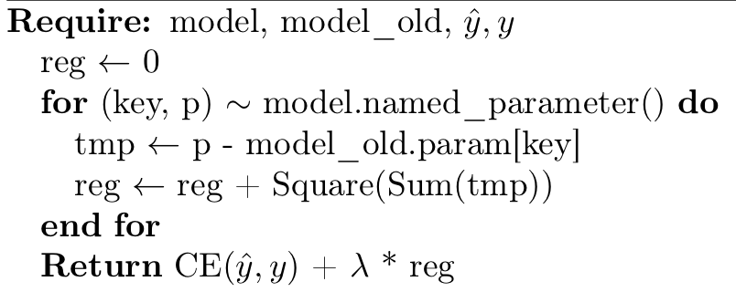
Goal of Lab for EWC
Criterion(self, output, targets)
Pseudo code

Slide 18
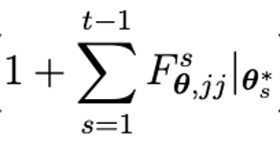
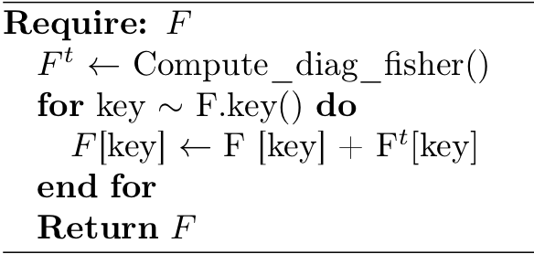
Goal of Lab for EWC
Update_fisher(self, device=None)
In the above equation, adding 1 can be omitted
Pseudo code

Slide 19
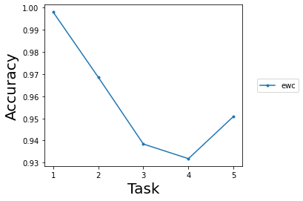
Goal of Lab for EWC
Plot a figure for results
Source codes for visualization are already implemented
x-axis and y-axis of a figure represent the number of tasks learned so far and the average accuracy, respectively

Slide 20
Goal of Lab for ER
Experimental Setting
Network architecture : 2 layers MLP network with multi-head
Continual learning scenario : Split MNIST with 5 tasks
Off-line setting (different from the original paper)
Complete unimplemented functions of ER
Implement two functions in day1_er.ipynb
Update_memory(self, memory, loader, memory_size) Sample_with_memory(self, data, target)
Plot a figure for the results of EWC and ER

Slide 21
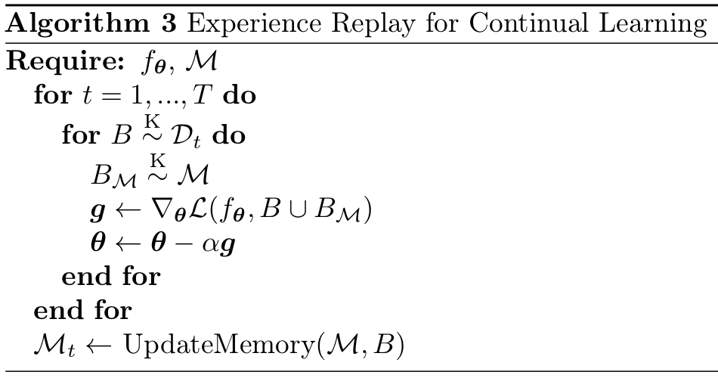
Goal of Lab for ER
Implement two functions
Update_memory(self, memory, loader, mem_sz) : After learning the current task, update a repaly memory through Resorvoir Sampling
In offline setting, we need to update the memory after learning a task
Sample_with_memory(self, memory,data, target,mem_sz, batch_sz) : Make a mini-batch by sampling some data in replay memory
Sample_with_memory()
Update_memory()

Slide 22
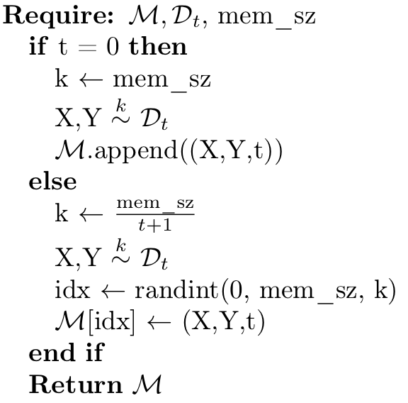
Goal of Lab for ER
Update_memory(self, memory, loader, mem_sz)
Psuedo code
If t is not 0, we have to randomly pop items in replay memory
We must also include task id

Slide 23
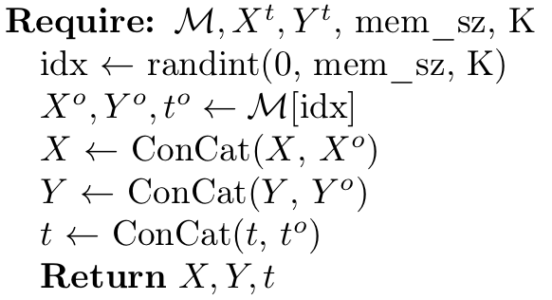
Goal of Lab for ER
Sample_with_memory(self, Memory, data, target, mem_sz, batch_sz)
Psuedo code

Slide 24
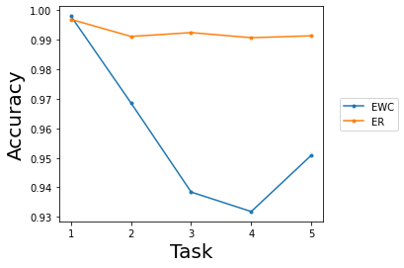
Goal of Lab for ER
Plot a figure for results
Source codes for visualization are already implemented
x-axis and y-axis of a figure represent the number of tasks learned so far and the average accuracy, respectively

Slide 25
Outline
Review of EWC and ER
Goal of Lab
A Brief Explanation for Source Codes

Slide 26
Program Structure
Program structure mainly consists of three parts
Network module
Produces a trainable neural network through a function "ModelFactory”
Data_handler module
Declare a pre-defines loader that produces sequential tasks
Trainer module
Continual learning algorithms are implemented in this module
We need to complete scripts of EWC and ER

Slide 27
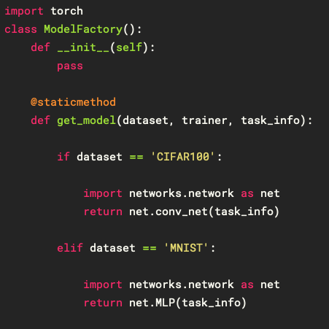
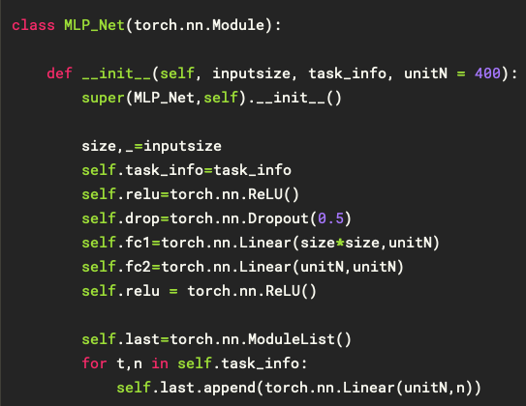
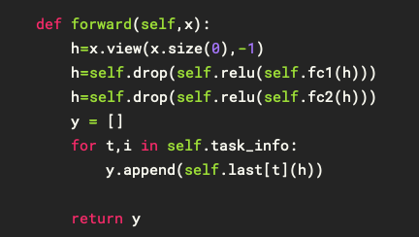
Program Structure
Program structure mainly consists of three parts
Network module
Produces a trainable neural network through a function "ModelFactory”
<Impl. of Forward() >
<ModelFactory>
<Initialize of NN>

Slide 28
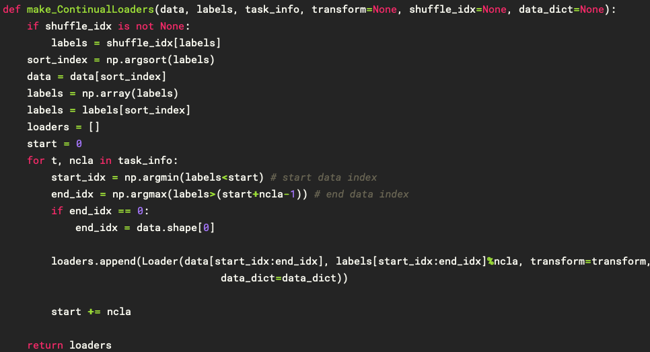
Program Structure
Program structure mainly consists of three parts
Data_handler module
Declare a pre-defines loader that produces sequential tasks through a function “make_ContinualLoaders”
<Impl. Of make_ContinualLoaders()>

Slide 29
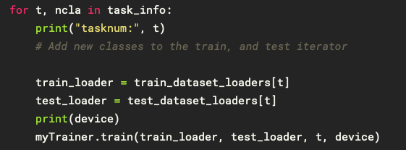
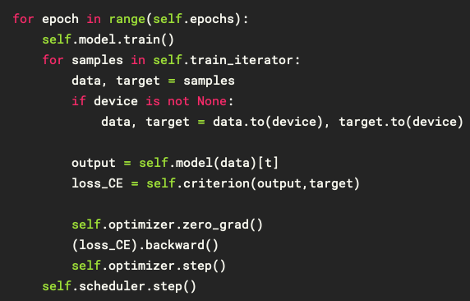
Program Structure
Program structure mainly consists of three parts
Trainer module
Continual learning algorithms are implemented in this module
train() function in Trainer class is called for each task
In train() function, call forward() and backward() during pre-defined epochs

